Slide 1

Being a Safeguarding Champion

Slide 2

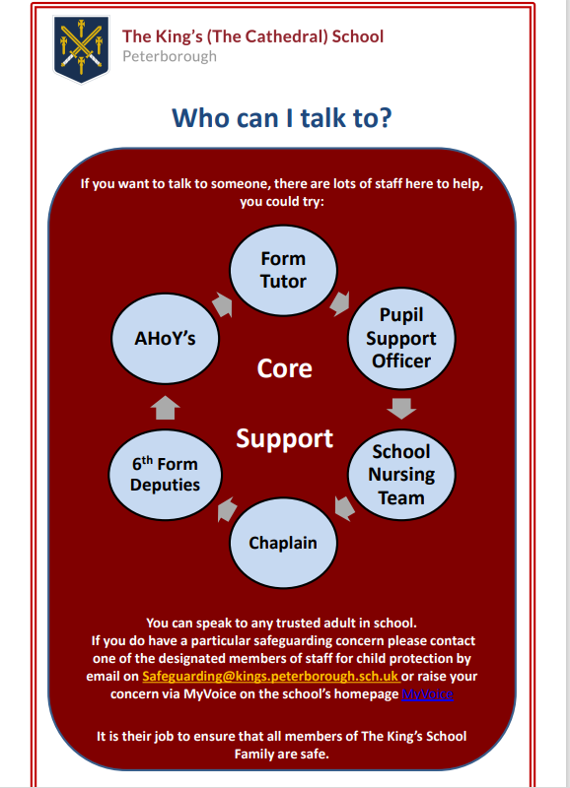
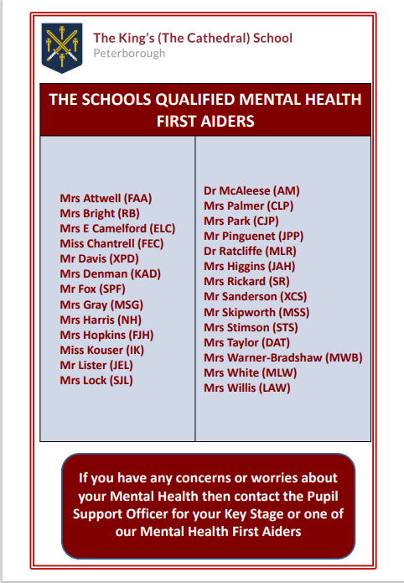

Who do I go to if I am worried or have an issue?
Notes:
We all get worried from time to time, and we would like you to feel that you can reach out to someone at school. All staff are safeguarding trained, so the answer is that if you have your ‘go to’ trusted adult in school, you can, of course go to them (poster one). We are all here to help and support you in anyway we can. Some staff are also trained in mental health first aid, if they are, they should have a sign displayed on their classroom or office door, here is the list of the staff that are currently trained (poster two). But you might not feel you want to go to anyone at all, in which case…

Slide 3
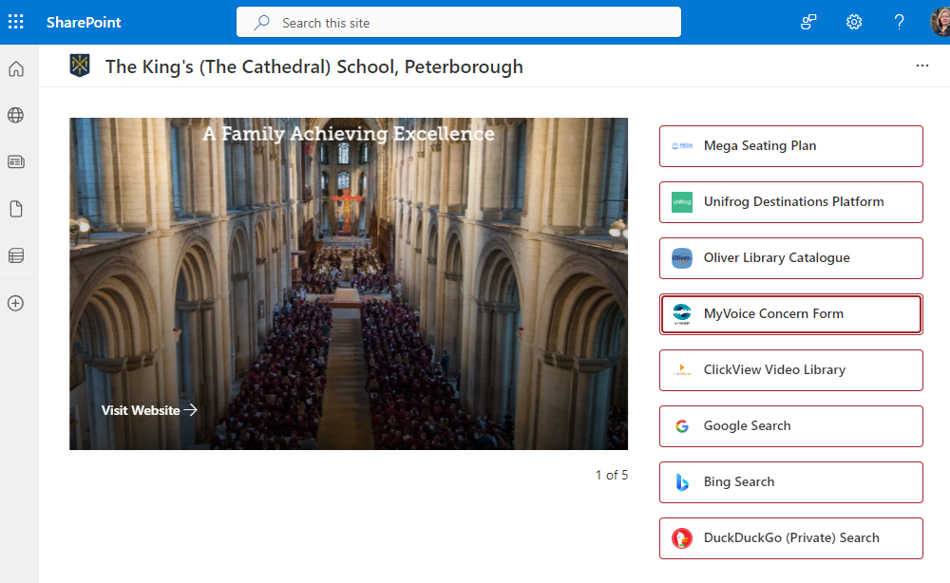
Notes:
Go onto the school website, and on the left-hand banner there are various links, the fourth one down is for ‘MyVoice’. MyVoice is a reporting tool specifically designed for students to share their concerns

Slide 4
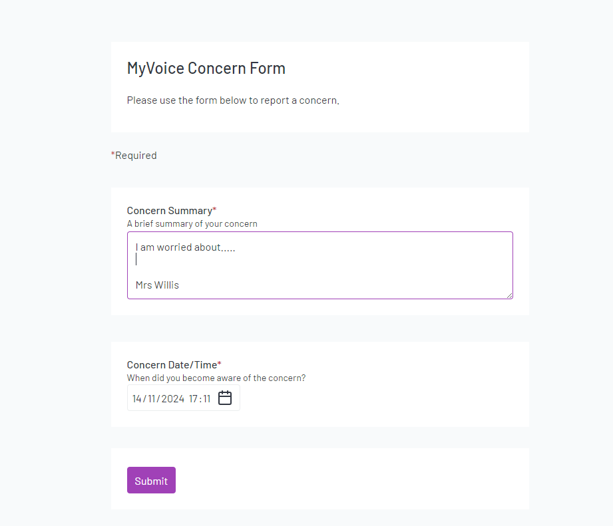
Notes:
This screen will come up and you briefly summarise your concern or who your concerns are about, and then you can choose to leave your name at the bottom of the concern, or not - it is entirely up to you, but if you feel we need more information its best to let us know who bravely completed the form. Just remember if it’s worrying you, a problem shared is a problem halved. This form only goes to one of the child protection team who are:

Slide 5
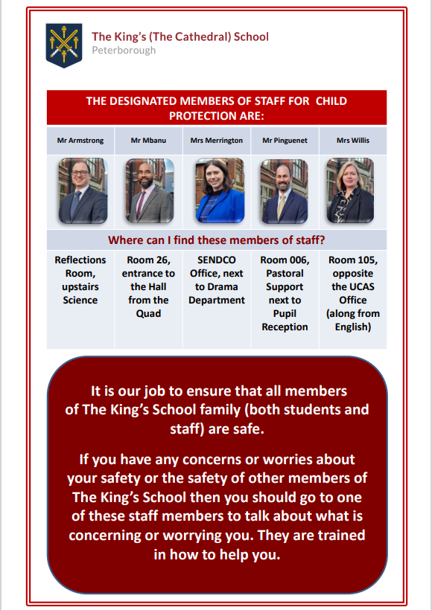

Slide 6
Unwanted People on our Site

Slide 7

How would you know if they are unwanted or unwelcome?
They wouldn’t be wearing a lanyard.
So, what if they don’t have a lanyard on at all?
Notes:
Our site is protected by CCTV, we have a fence that surrounds both the main site, as well as Madeley House, staff are on duty at peak times of the day and you need to use a swipe card to access the gates. We have lots of measures in place to try and keep you safe at all times, we also recognise from time to time somebody might try and enter our site, who is unwanted, unwelcome and therefore potentially unsafe.
If you ever encounter somebody on site like this you should inform the nearest member of staff and leave them to deal with it, and if there is an immediate threat then hide.
Sound two different alarms - fire alarm first, intruder alarm for comparison.
If this alarm goes off, like the fire alarm you should follow the instructions of the members of staff, whether that be in the classroom, out on the cage or anywhere else in school, its important that you remain mature, calm, quiet and listen carefully to the instructions you are given. We have every faith in our students that you would do the right thing.

Slide 8
Travelling Safely to and from School
Notes:
Our recent student focus groups identified that students don’t always feel all that safe walking along the routes they take, particularly from the train and bus station. Thus, we have produced a map that identifies the most public, and therefore safest route that is best to be used

Slide 9
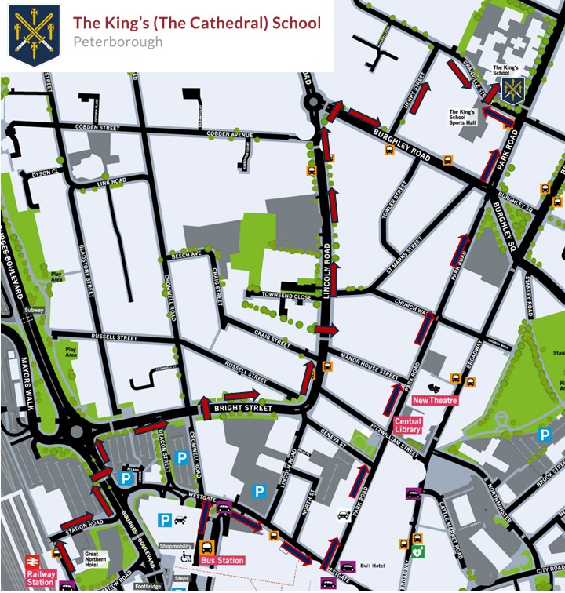
Notes:
Alongside the routes you see we would advise that:
You avoid situations that are unsafe, walk on the other side of the road when you see a large group of people you don’t know
Don’t talk or interact with anybody you don’t know
Don’t have your phone on display, it could easily get taken from your hand
Ideally walk in pairs or threes but try not to block the path
School gates open at 7.45 so time your journey so that you arrive after this time, and anywhere up to 8.25, you should be on site and on your way to form time then

Slide 10


